Slide 1
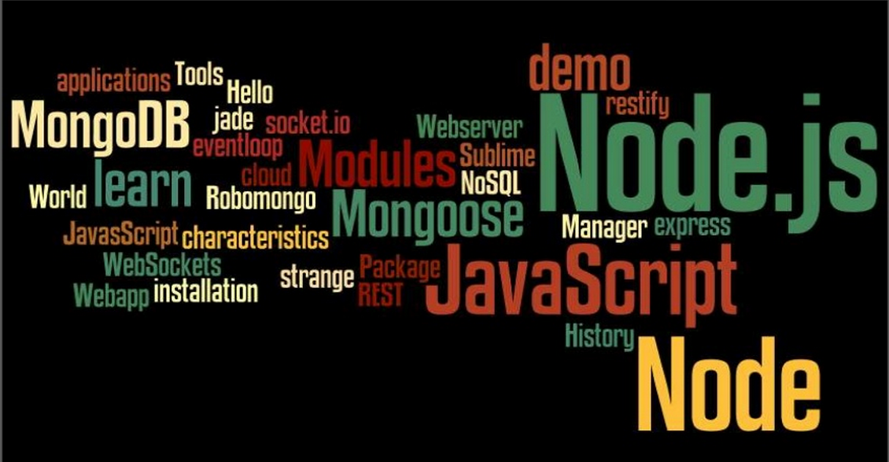

Slide 2
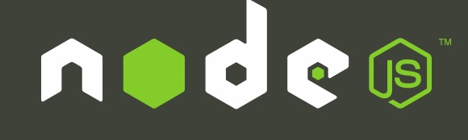
What is Node?
Node is an open source toolkit for developing server side applications based on the V8 JavaScript engine. Like Node, V8 is written in C++ and is mostly known for being used in Google Chrome.
Node is part of the Server Side JavaScript environment and extend JavaScript API to offer usual server side functionalities.
As an asynchronous event driven framework, Node.js is designed to build scalable network applications.

Slide 3
Why Node ?
Performance and scalability .
V8 compiles and executes javascript at lightning speed. Because it compiles java script into native machine code.
Event Loop: Single thread that performs all IO operations asynchronously. ( Getting through Call back functionality).
Reading data from file systems/DB executes very fast, robust and consistent.
Tools
NPM (node.js Package Manager) : Installing project dependent files and assemblies. This is very quick to get the libraries.

Slide 4
Architecture
Design the system to use end to end
javascript. Client->Server->Persistence layer.
NodeJS : For the server side. We will use Socket.IO to manage long-terms real-time connection.
Google Chrome Extension : For the client side. WebSocket, Notification and Local Storage will be used.
MongoDB/Couch DB : To store the datas.
Real time Made Easy
Concurrent connections are very fast and Nodes event loop takes care of multi user requirement. Really good in chat and games etc.
Perfect for offering a RESTful API.

Slide 5
Node – The framework
Node is not strictly for web development. In fact, you can think of Node as a framework for server development of any kind. With Node you can build an IRC server, a chat server, or, as we'll see in this set of tutorials, an http server
Express.js is the most popular Node.js web application framework used today. It seems to be the base dependency in most Node.js web applications.
Three Built in frameworks
Express
Koa
Hapi

Slide 6
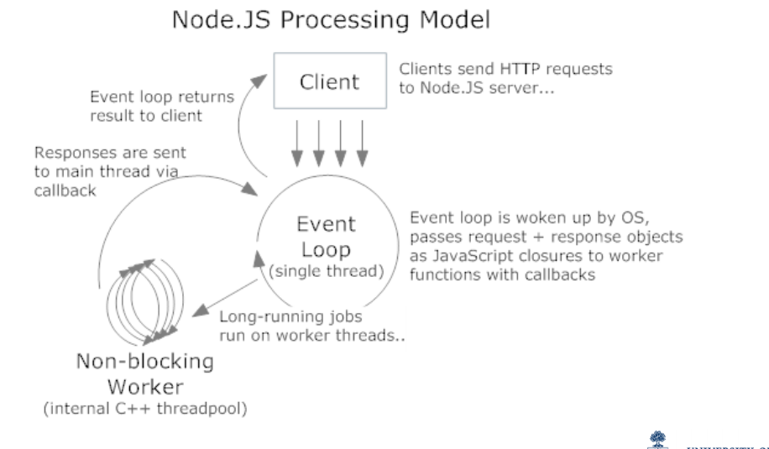
Node.JS Processing Model
A client makes a request for some I/O (eg. reading a file)
The event loop, which is running on a single thread, responds by passing the request off to some non-blocking workers. (These workers are not exposed to your code so you don't really need to worry about them.)
When the worker threads are ready, the response is sent back to the main event loop via the callbacks.

Slide 7
Asynchronous Callbacks
The typical pattern in Node.js is to use asynchronous callbacks. Basically you're telling it to do something and when it's done it will call your function (callback).
This is because Node is single-threaded. While you're waiting on the callback to fire, Node can go off and do other things instead of blocking until the request is finished.
This is especially important for web servers. It's pretty common in modern web applications to access a databases. While you're waiting for the database to return results Node can process more requests.
This allows you to handle thousands of concurrent connections with very little overhead, compared to creating a separate thread for each connection.

Slide 8
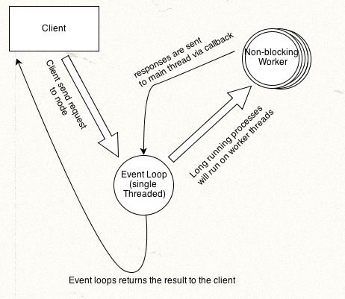
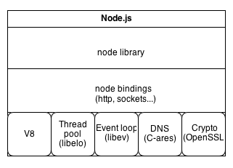
Node.JS architecture
Node.js is event-driven with Non-blocking I/O.
Uses a Event Loop for Non Blocking I/O.
Node.js is single threaded.

Slide 9
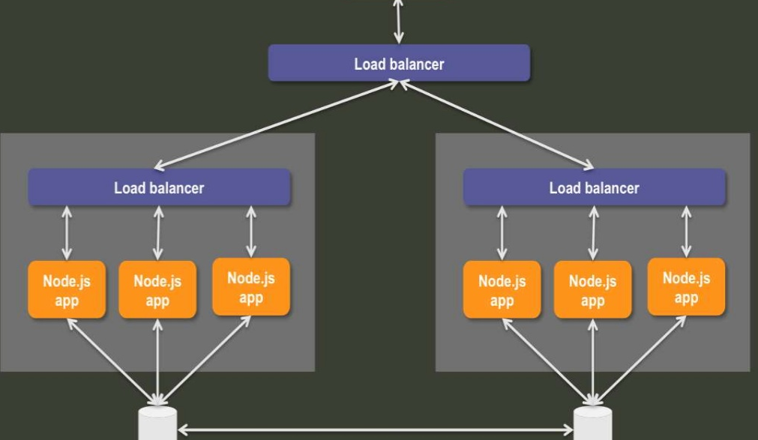
Infrastructure Architecture

Slide 10
Disadvantageous
Lots of data base drivers and modules are unstable.
Not well suited for relational DB’s.
Lack of standard library.
CPU intensive tasks are not advisable.

Slide 11

Any Body Using It?

